Slide 1
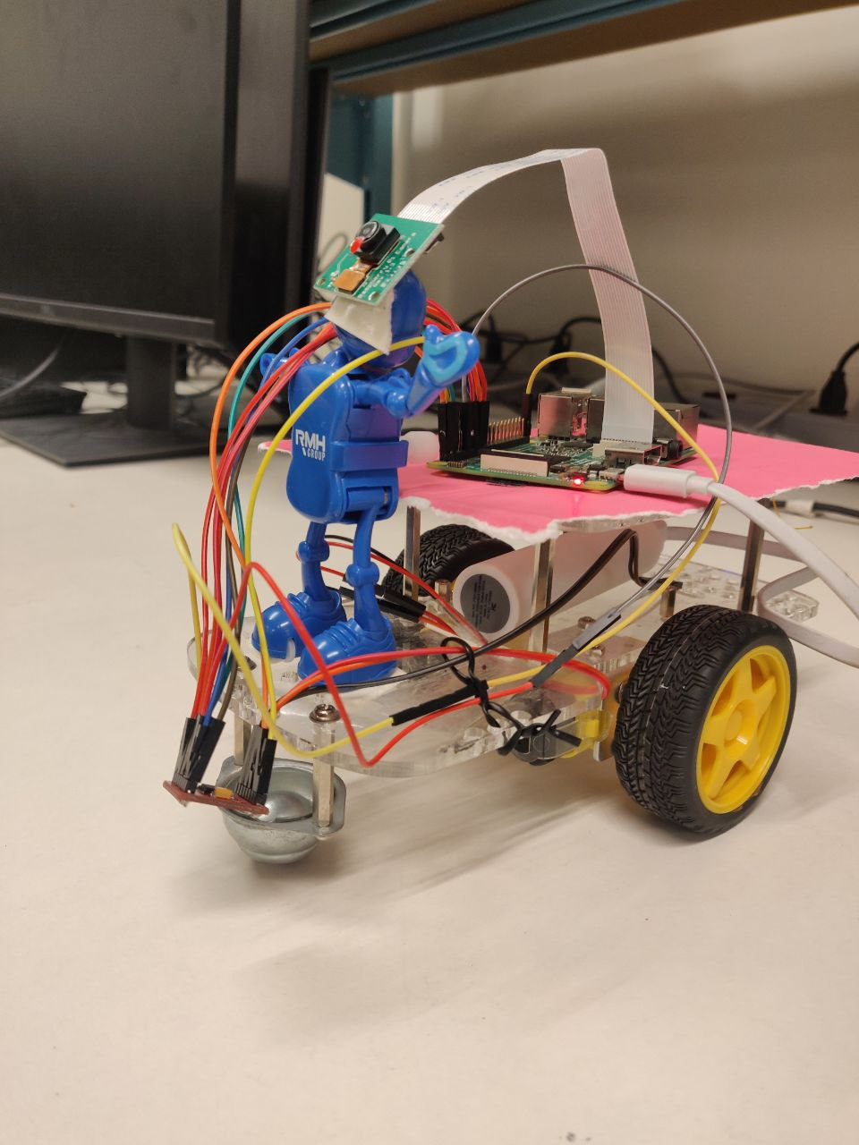
Autonomous Car Braking System
ECEN 5623 - Real Time Embedded Systems
Under : Professor Timothy Scherr
Project Members:
Aaksha Jaywant
Atharv Desai

Slide 2
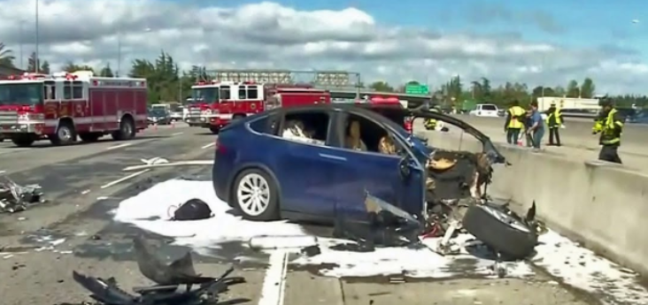
Motivation Behind the Project
Tesla Car Accident due to autopilot mode on Highway 101
Aim : To augment the Reliability of the Autonomous Car Braking System

Slide 3
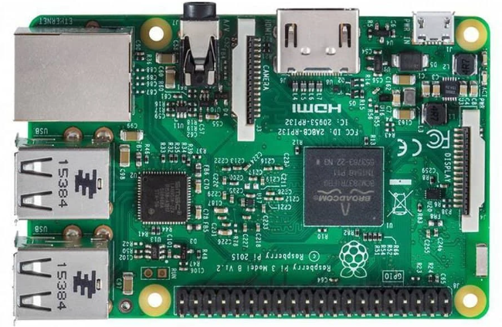
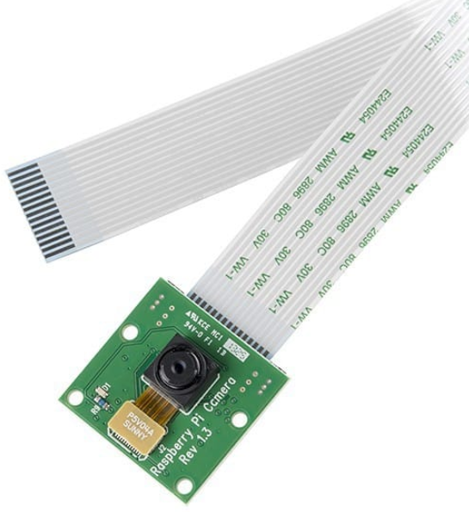
PROJECT REQUIREMENTS : HARDWARE
Raspberry Pi 3
Raspberry Pi Camera

Slide 4
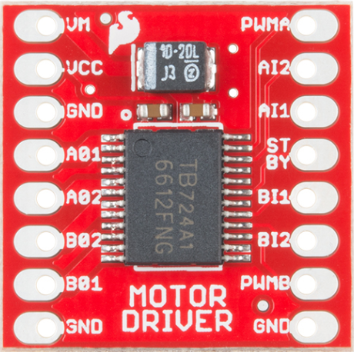
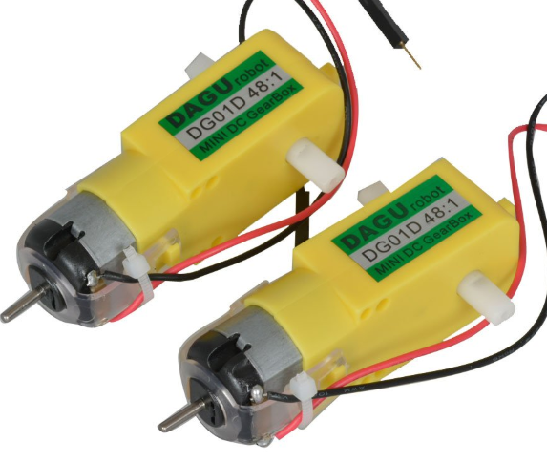
3) Motor Driver TB6612FNG
4) DC Motor

Slide 5
PROJECT REQUIREMENTS : SOFTWARE
Open CV Library for Image processing
Wiring Pi Library for enabling GPIO
RaspiCam for C++ functions to operate Raspberry Pi camera
SSH Remote Login to Raspberry Pi

Slide 6
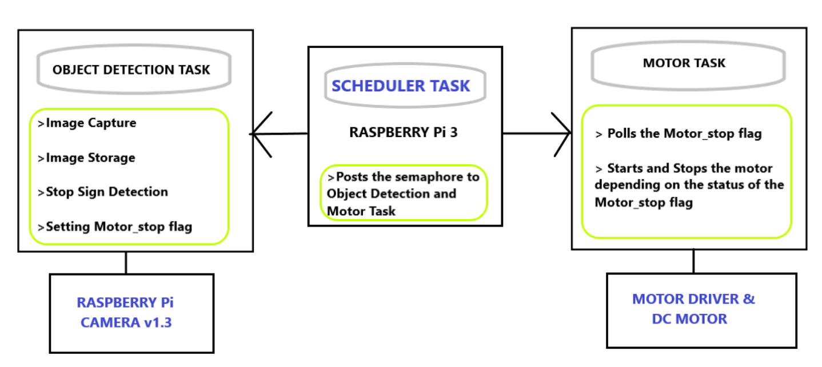
FUNCTIONAL REQUIREMENTS
-BLOCK DIAGRAM

Slide 7
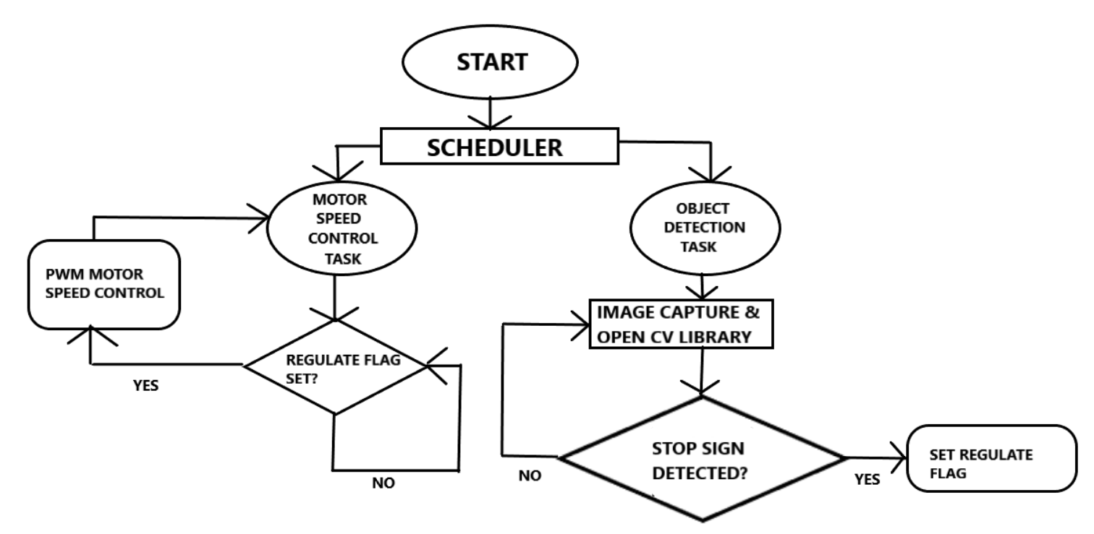
FUNCTIONAL REQUIREMENTS
CONDITIONAL FLOW OF THE PROJECT

Slide 8
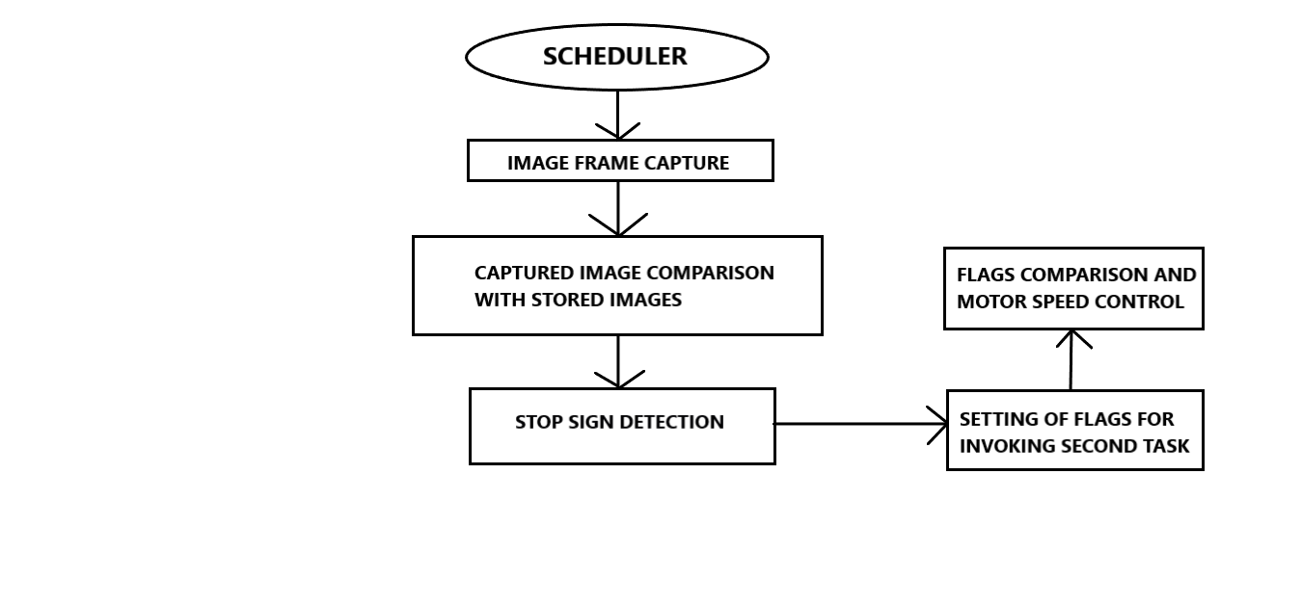
FUNCTIONAL REQUIREMENTS
SEQUENCE DIAGRAM

Slide 9
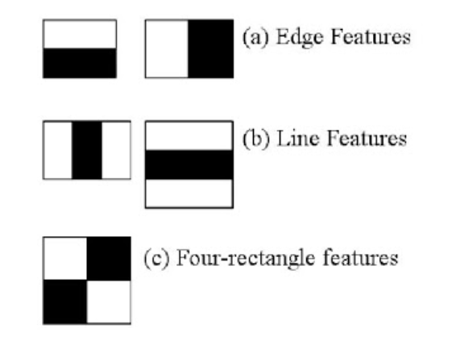
Object Detection using Haar Cascade Classifier
Based on Input Positive and negative Images, the classifier is trained
Haar Features used
to extract features
from images

Slide 10
Haar Cascade Classifier Features used in the Implementation
cascade.detectMultiScale
→ to detect images of different sizes
cascade.load
→ to load xml classifier files
→ stopsign Haar19stages.xml file used

Slide 11
SoftPWM & WiringPi Library for GPIO Configuration on Raspberry Pi 3
softPWMCreate
softPWMWrite
DigitalWrite

Slide 12
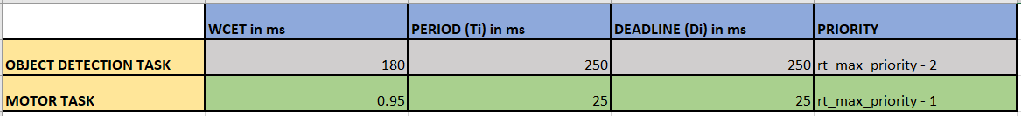
REAL-TIME REQUIREMENTS
-WCET, Period & Deadline

Slide 13
REAL-TIME REQUIREMENTS
WCET ANALYSIS
The WCET of the Motor task was around 0.95ms since it involves setting of GPIO pins which were configured using WiringPi API library.
The WCET of the Object Detection Task was around 180ms since it involves continuous video capture.

Slide 14
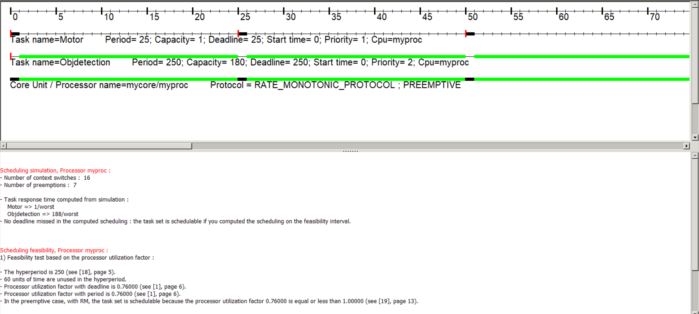
CHEDDAR ANALYSIS

Slide 15
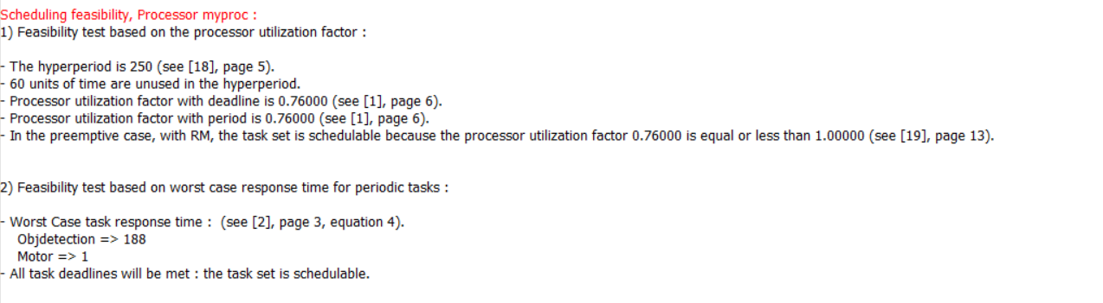
CHEDDAR ANALYSIS CONTD.

Slide 16
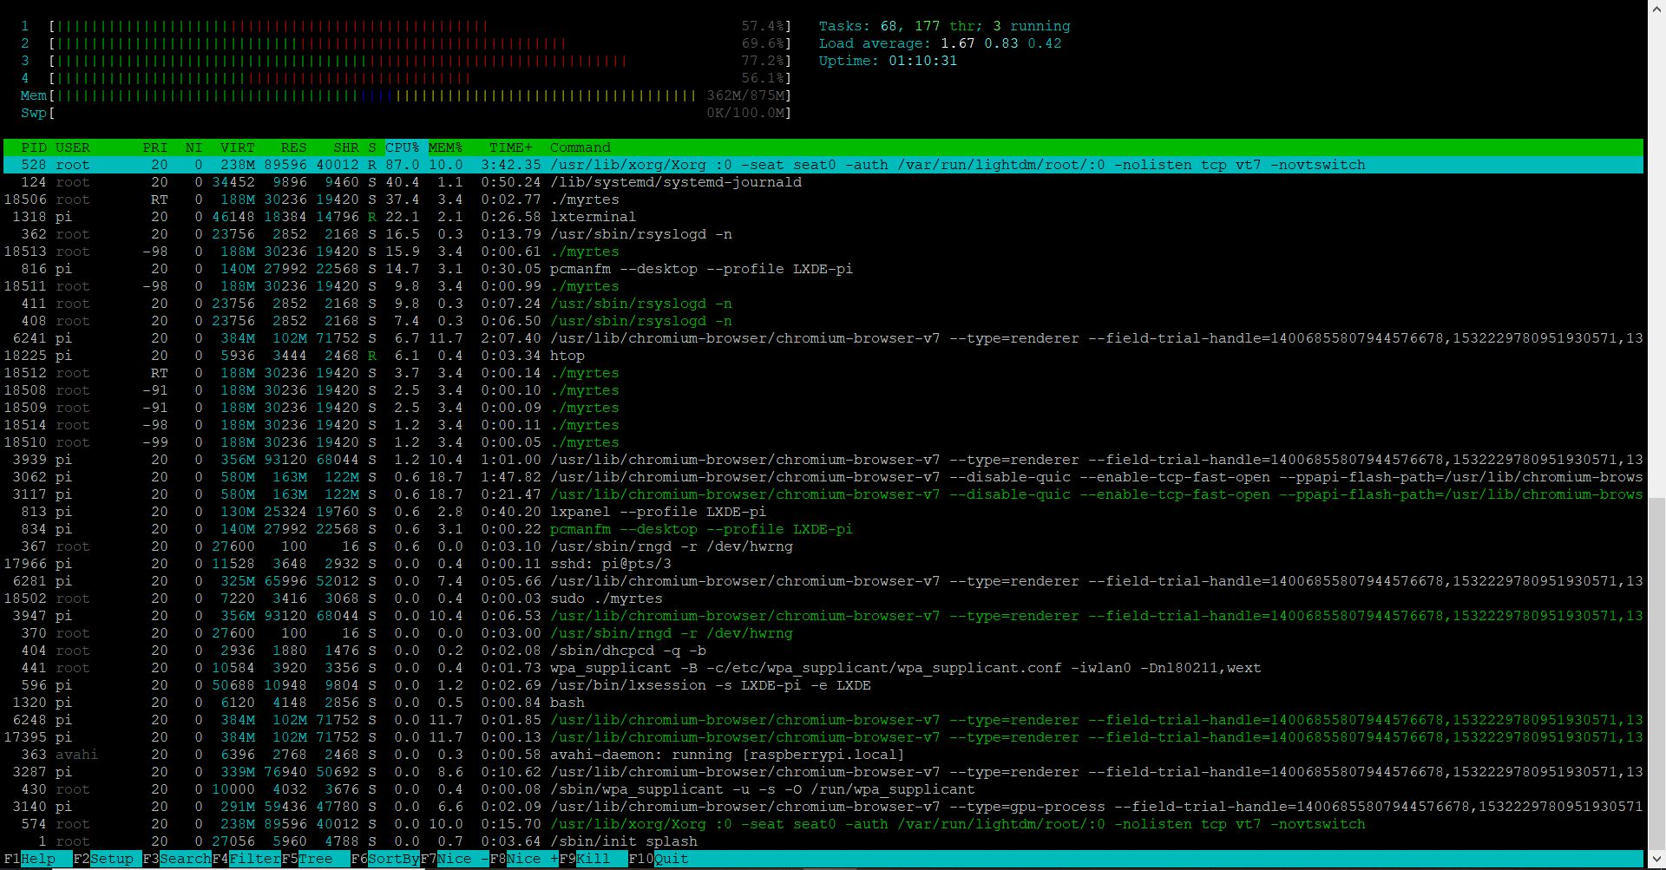

Slide 17
THANK YOU

